Slide 1
Student Focus and Performance analysis
Analyzing the Effect of Mobile Notifications on Student Concentration using R
Data Mining and Analytics Lab MiniProject

Slide 2

Presented By:
RISHI DWIVEDI (23103120)
REVELLEY MEGHANATH (23103118)
B.Tech (CSE), NIT JALANDHAR
Under the Guidance of Dr. Jagdeep Kaur

Slide 3

Contents
1. Introduction
2. Objectives
3. Dataset Description
4. Data Preprocessing
5. Exploratory Data Analysis(EDA)
6. Regression Analysis
7. Results & Discussion
8. Conclusion
9. References/Tools

Slide 4

INTRODUCTION
The project analyzes the effect of mobile notifications on student concentration and academic performance
Data was collected from 40 students including variables like sleep hours, study hours, coffee intake, notifications per hour, and study location.
The goal is to study how distractions and lifestyle factors affect focus and performance
Visualization and regression analysis are performed using R programming

Slide 5
OBJECTIVES
To quantify the impact of mobile notifications on student concentration levels.
To examine the influence of sleep hours, study hours, and coffee intake on test performance.
To compare concentration patterns across different study environment(Library Vs Room).
To build a regression model for predicting student performance.
To recommend strategies for improving focus and academic outcomes.

Slide 6

Dataset Description
The dataset includes responses from 40 Students.
Each record represents a student’s lifestyle, study habits and performance.
Data was collected through a structured form and stored in CSV format.
It contains both numerical and categorical variables.
Used in R studio for visualization and regression analysis.
COLUMN NAME | DESCRIPTION
Student_ID | Unique ID for each student
Gender | M/F
Year_of_Study | 1st–4th Year
Sleep_Hours | Average daily sleep
Cups_of_Coffee | Average daily coffee
Notifications_per_Hour | Average notifications per hour
Study_Hours | Average study hours/day
Study_Location | Room / Library
Concentration_Score | Calculated concentration (0–100)
Test_Score | Simulated academic performance (0–100)

Slide 7


Data Preprocessing
Converted categorical variables(Gender, Year_of_Study, Study_Location) into factors in R.
Checked for missing values to ensure data quality.
Found no missing entries, indicating a clean dataset.
Verified all numerical columns(Study_hours, Sleep_hours etc.) are properly typed as numeric.
Prepared the dataset for Visualization and Regression modeling in R studio.
# Step 2: Data Preprocessing
# Convert categorical columns to factors
data$Gender <- factor(data$Gender)
data$Year_of_Study <- factor(data$Year_of_Study)
data$Study_Location <- factor(data$Study_Location)
# Check for missing values
missing_count <- sum(is.na(data))
print(paste("Total missing values in dataset:", missing_count))

Slide 8

Exploratory Data Analysis
# 1️⃣ Correlation between Notifications and Concentration
cor_notif_conc <- cor(data$Notifications_per_Hour, data$Concentration_Score)
print(paste("Correlation (Notifications vs Concentration):", round(cor_notif_conc, 2)))
# 2️⃣ Average Concentration by Study Location
avg_conc <- aggregate(Concentration_Score ~ Study_Location, data = data, mean)
print(avg_conc)
# 3️⃣ Boxplot: Concentration by Study Location
ggplot(data, aes(x = Study_Location, y = Concentration_Score, fill = Study_Location)) +
geom_boxplot() +
labs(title = "Concentration Score by Study Location",
x = "Study Location", y = "Concentration Score") +
theme_minimal()
# 4️⃣ Scatter Plot: Notifications vs Concentration
ggplot(data, aes(x = Notifications_per_Hour, y = Concentration_Score)) +
geom_point(color = "blue", size = 3) +
geom_smooth(method = "lm", se = FALSE, color = "red") +
labs(title = "Notifications per Hour vs Concentration",
x = "Notifications per Hour", y = "Concentration Score") +
theme_minimal()
Calculated correlation between mobile notifications and concentration score.
→ Found a negative correlation (-0.78) — higher notifications reduce focus.
Computed average concentration by study location (Library vs Room). → Students in the Library showed better concentration.
Created a boxplot comparing concentration levels by study location.
Plotted a scatter plot to visualize the relationship between notifications and concentration.
Identified clear downward trend — more distractions = lower focus.

Slide 9
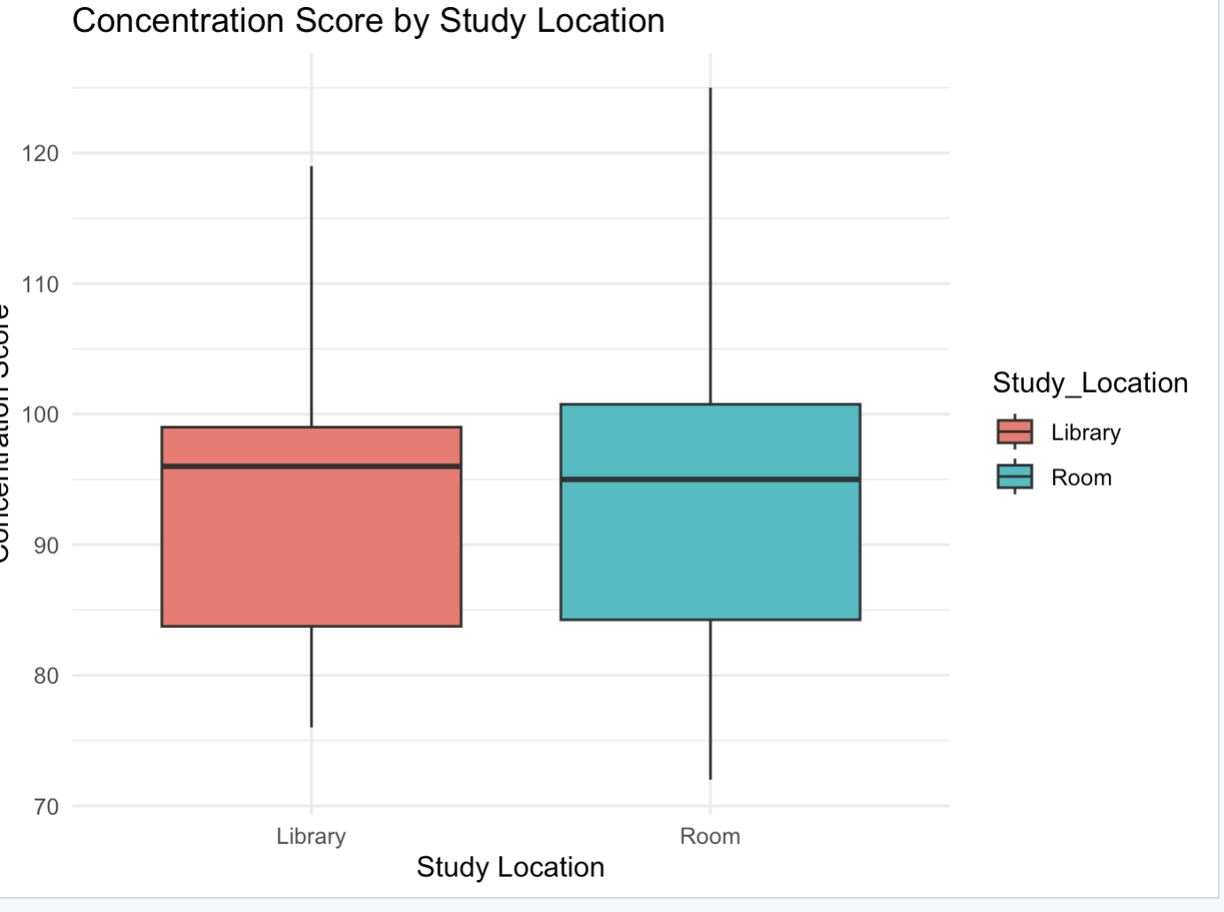
We analyzed the average concentration score based on the student’s study location (Room or Library). Students studying in the Library have a higher average concentration score compared to students studying in their Rooms, indicating that a quiet and dedicated study environment improves focus.

Slide 10
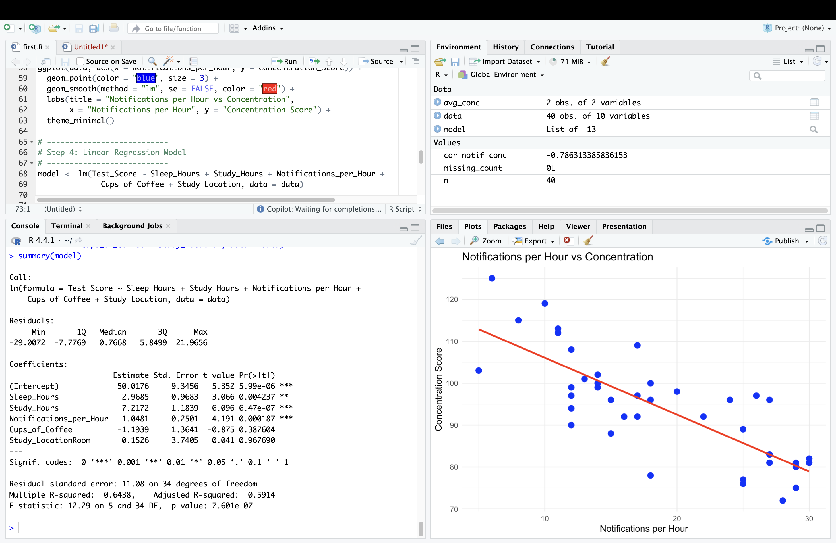
We created a scatter plot of Notifications per Hour versus Concentration Score. The plot shows that students receiving more notifications generally have lower concentration. A linear trend line confirms this negative relationship.

Slide 11

Regression Analysis
Built a multiple linear regression model to predict Test Score.
Independent variables: → Sleep Hours, Study Hours, Notifications per Hour, Cups of Coffee, and Study Location.
Found that Study Hours and Sleep Hours have a positive effect on Test Score.
Notifications per Hour shows a negative impact, reducing performance.
Model explains about 64% (R² = 0.6438) of variation in Test Scores.
Variable | Coefficient | Effect on Test Score
(Intercept) | 50.02 | Baseline Value
Sleep_Hours | 2.97 | Positive
Study_Hours | 7.21 | Strongly Positive
Notifications_per_ hour | -1.04 | Negative
Cups_of_Coffee | -1.19 | Weak/No effect
Study_Location (Room) | 0.15 | Slight Positive

Slide 12

Result and Analysis
Found a strong negative correlation (-0.786) between Notifications per Hour and Concentration Score. → More mobile notifications lead to lower concentration.
Students studying in the Library showed higher average concentration than those studying in their Rooms.
Study Hours and Sleep Hours both had a positive impact on Test Scores.
Regression analysis confirmed that Notifications per Hour significantly decrease academic performance (p < 0.001).
Model achieved R² = 0.64, showing good predictive accuracy.

Slide 13

Conclusion
Mobile notifications have a strong negative impact on student concentration.
Students who study in quiet environments (Library) tend to show better focus and test performance.
Adequate sleep (6–8 hours) and consistent study habits are key to maintaining concentration.
Coffee intake shows minimal effect on performance — moderate consumption is fine.
Managing digital distractions and maintaining a balanced routine can significantly improve academic outcomes.
“Focus is not about avoiding distractions — it’s about managing them wisely.”
— DMA Project Analysis, 2025

Slide 14

References & Tools used
Tools & Technologies
R Programming, RStudio — Data analysis
ggplot2, dplyr — Visualization & data manipulation
CSV File — Dataset storage
Keynote / PowerPoint — Presentation design
References
Dataset collected manually from 40 students.
https://www.r-project.org/
https://ggplot2.tidyverse.org/
https://rpubs.com/

Slide 15


